Slide 1

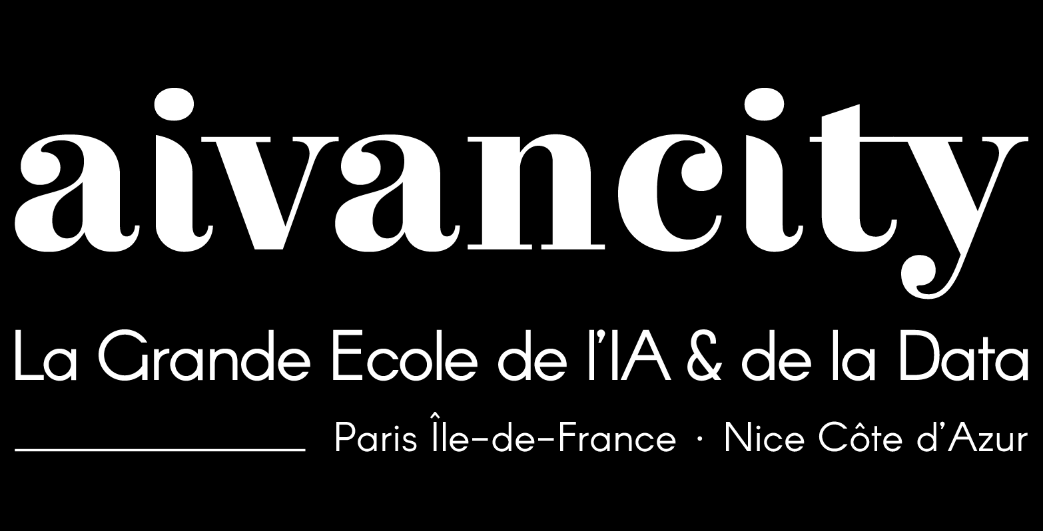

Future of AI
29/10/2025
Generative AI & Multimodal systems for creativity

Slide 2
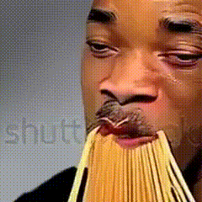
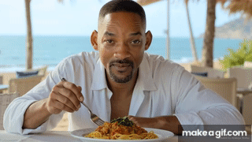
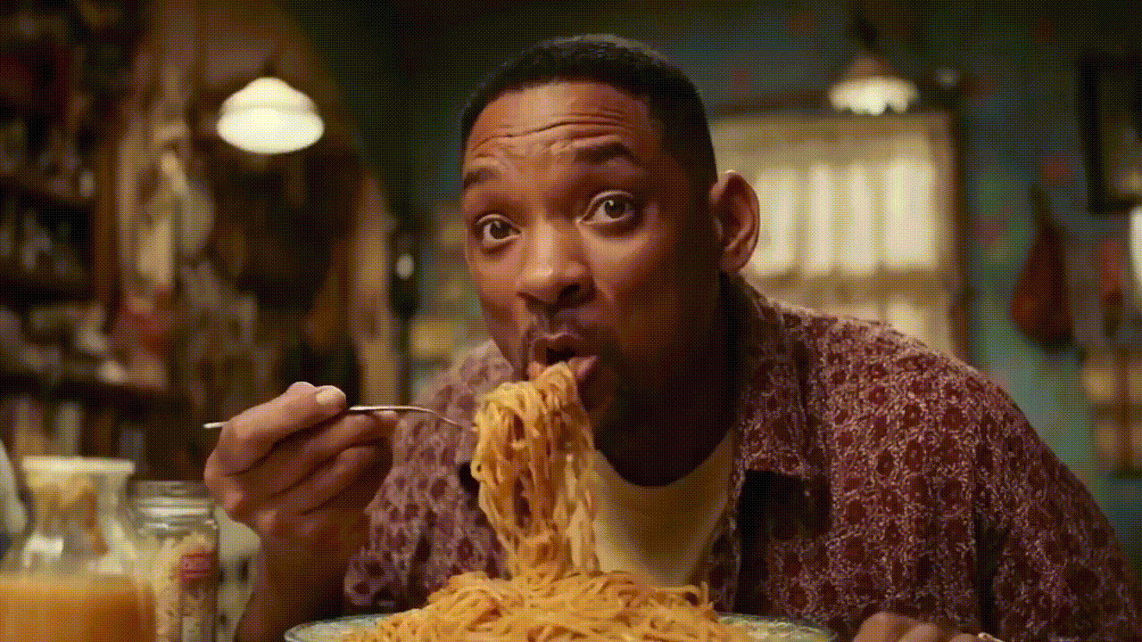

2023
2024
2025
October 2025 |

Slide 3
2023
2024
2025
Research/Public thinkering
Model scope (text-to-video)
Stable Video Diffusion
Runway Gen1
Runway Gen3 Alpha
OpenAI Sora
Google VEO 2
Longer, multi-shot
Google VEO 3
Sora 2
October 2025 |

Slide 4
Image vs Video Generation, any Differences?
Video generation is image generation with time – but time changes everything!
Video generation adds physics, temporal coherence and multimodal alignment challenges.
However, both image and video generation models share core ideas:
Both aim to model the data distribution for conditioned generation
Built upon the same foundational paradigms (Diffusion, Flow matching, Autoregressive Transformers)
Both rely on latent spaces (VAE/VQ-VAE) to compress high-dimension data
October 2025 |

Slide 5
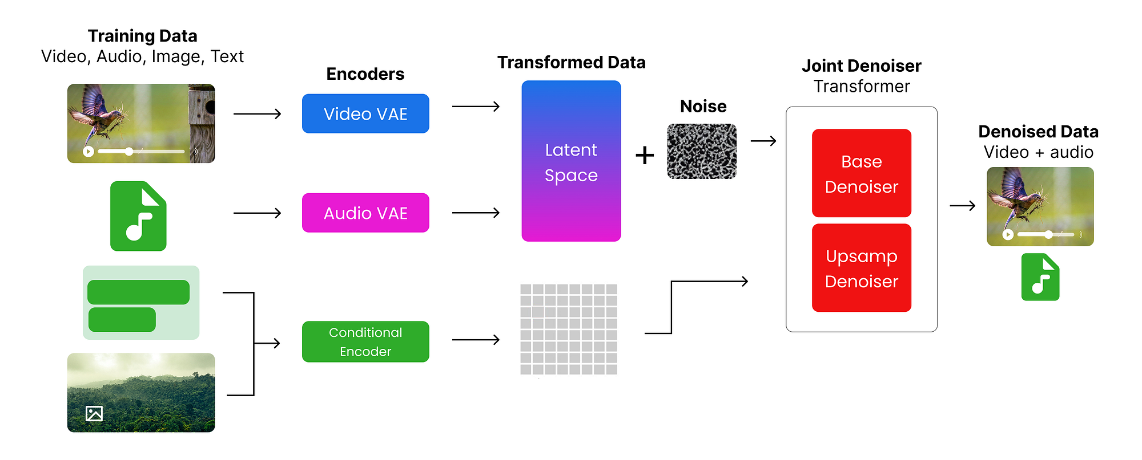
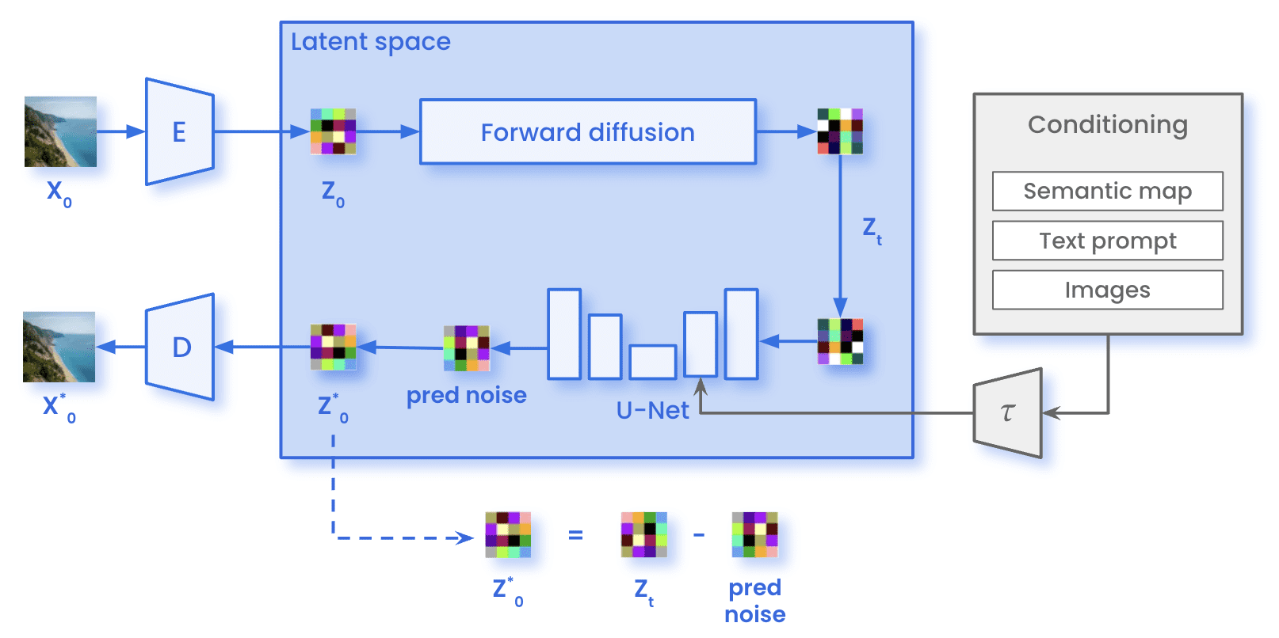
Image vs Video Generation, any Differences?
Veo 3 Architecture
Stable Diffusion Architecture
October 2025 |

Slide 6
High Dimensional Data Compression – Intuition
Instead of storing or processing all the details of the data, we seek a compact and structured way to capture the essential features, reducing redundancy and preserving the key information.
Efficient representations enable models to focus on meaningful patterns and relationships within the data.
Example:
Sequence A – 3, 7, 12, 19, 24
Sequence B – 1, 3, 5, 7, 9, 11, 13, 15, 17, 19, 21, 23, 25, 27, 29
October 2025 |

Slide 7
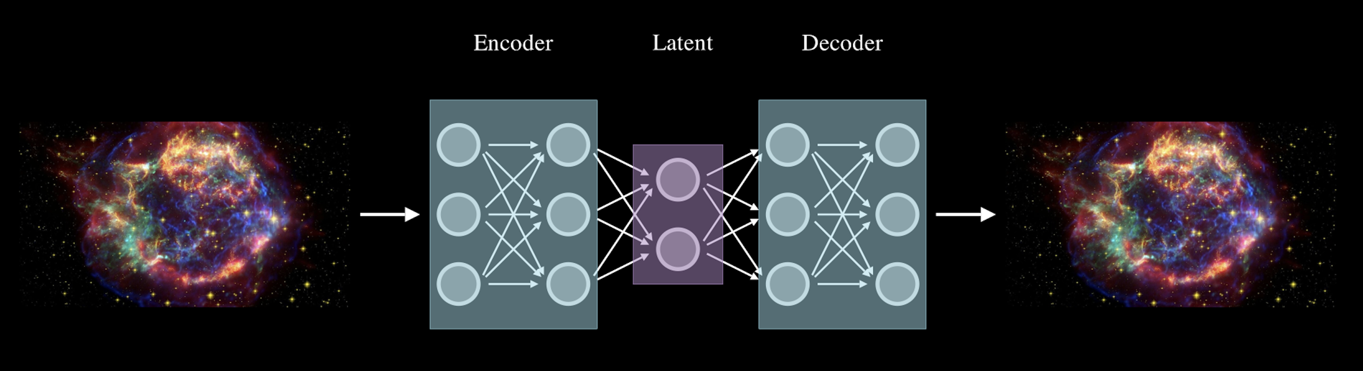
What are AutoEncoders?
Autoencoders are a type of neural network architecture designed to learn efficient data representations in an unsupervised manner.
Autoencoders learn to encode the input data into a compressed form and then decode it back to reconstruct the original input.
It consists of 2 main parts:
Encoder – compresses the input data into a lower-dimensional space (latent representation).
Decoder - takes the latent representation and reconstructs it back to match the original input as closely as possible
October 2025 |

Slide 8
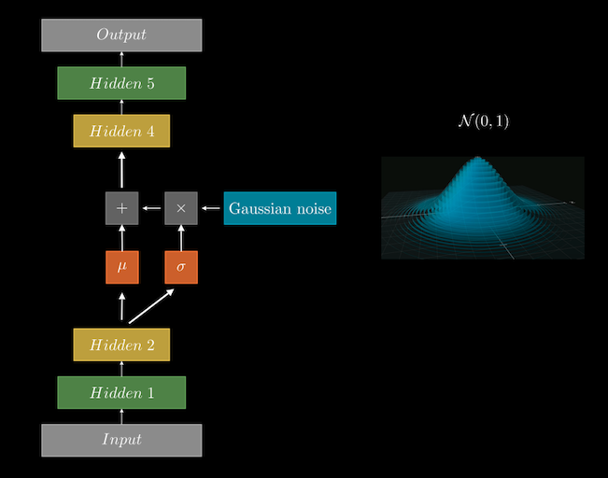
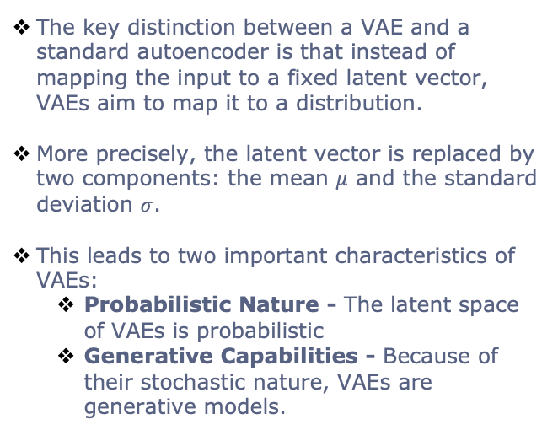
What about Variational AutoEncoders?
The key distinction between a VAE and a standard autoencoder is that instead of mapping the input to a fixed latent vector, VAEs aim to map it to a distribution.
More precisely, the latent vector is replaced by two components: the mean $μ$ and the standard deviation $σ$.
This leads to two important characteristics of VAEs:
Probabilistic Nature - The latent space of VAEs is probabilistic
Generative Capabilities - Because of their stochastic nature, VAEs are generative models.
October 2025 |

Slide 9
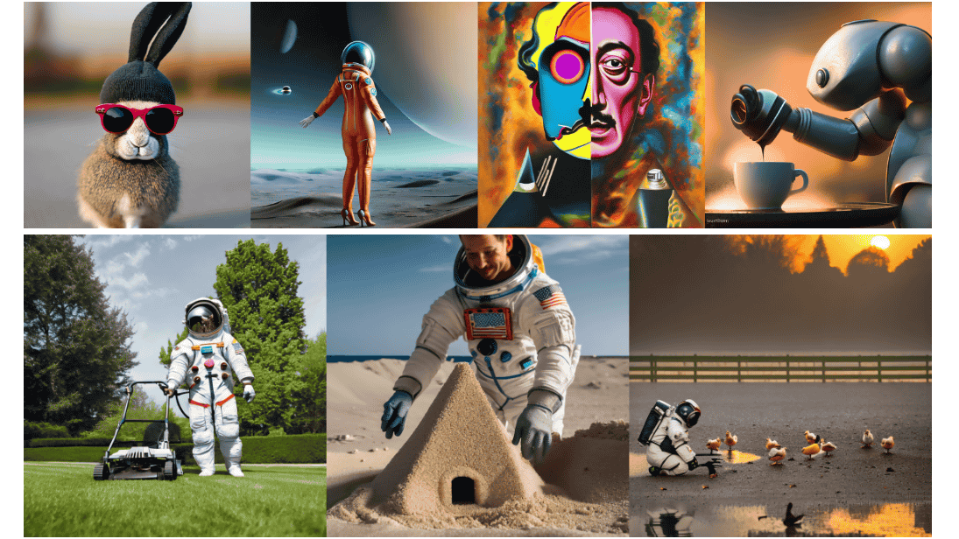
Diffusion Models
October 2025 |

Slide 10
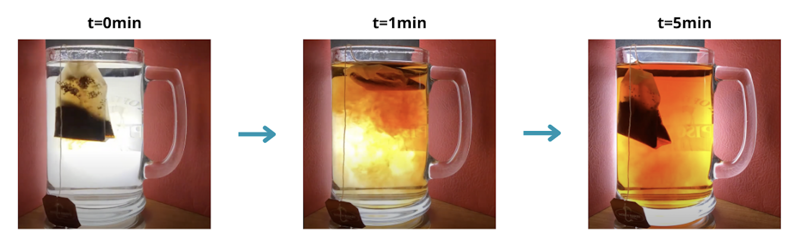
Diffusion Models
Diffusion models have emerged as a groundbreaking innovation in generative AI, with applications ranging from image generation to audio synthesis to video generation.
These models gained widespread attention in 2022, powering well-known tools like DALL·E and Google’s Veo 3, reshaping the landscape of creative AI.
At their core, diffusion models borrow inspiration from non-equilibrium thermodynamics, particularly the concept of diffusion.
October 2025 |

Slide 11
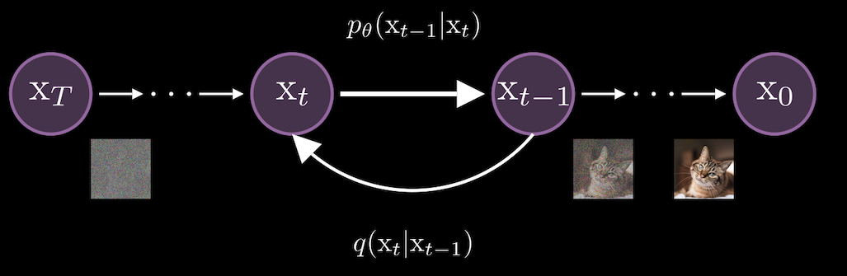
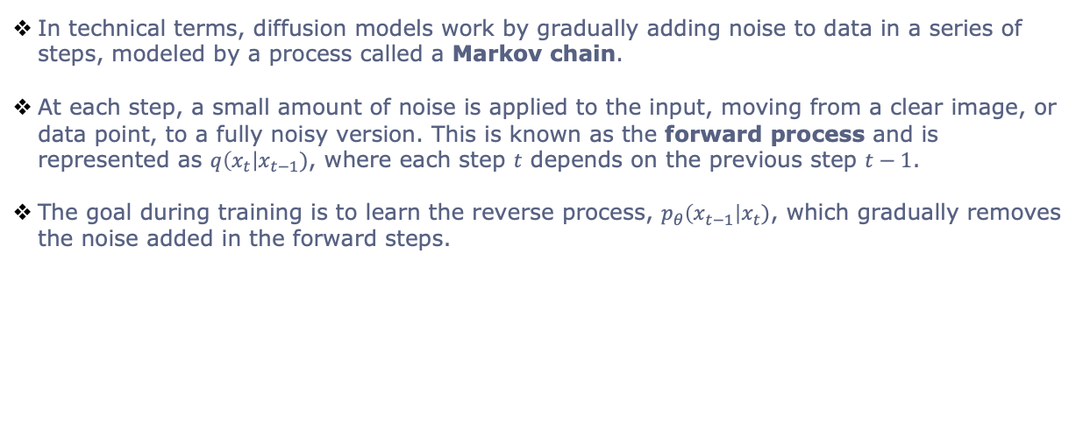
Diffusion Models – Forward Process
In technical terms, diffusion models work by gradually adding noise to data in a series of steps, modeled by a process called a Markov chain.
At each step, a small amount of noise is applied to the input, moving from a clear image, or data point, to a fully noisy version. This is known as the forward process and is represented as $q\left(x_{t}\right|x_{t−1})$, where each step $t$ depends on the previous step $t−1$.
The goal during training is to learn the reverse process, $p_{θ}\left(x_{t−1}\right|x_{t})$, which gradually removes the noise added in the forward steps.
October 2025 |

Slide 12
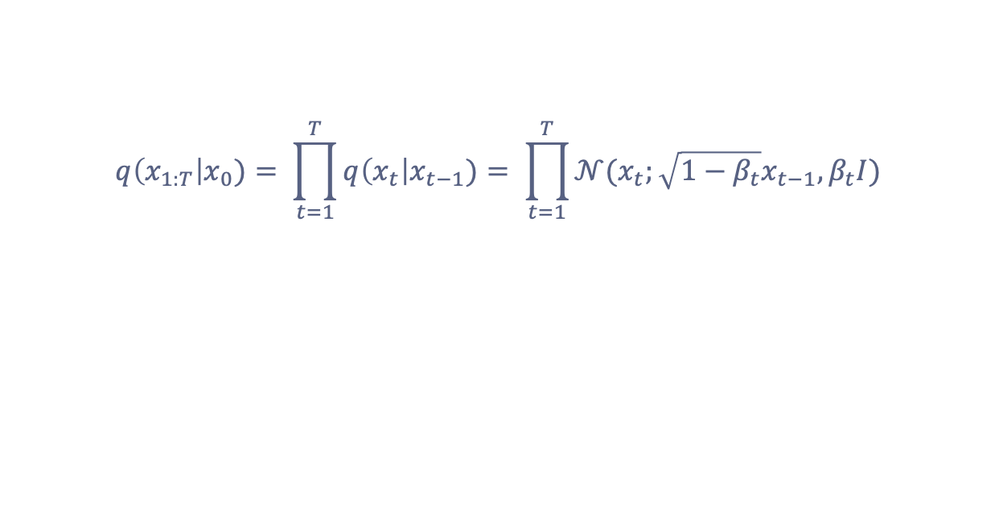
Forward Process Equation
$$q\left(x_{1:T}\right|x_{0})= \prod_{t=1}^{T}{q\left(x_{t}\right|x_{t−1})= \prod_{t=1}^{T}{𝒩(x_{t};\sqrt{1−β_{t}}x_{t−1},β_{t}I)}}$$
October 2025 |

Slide 13
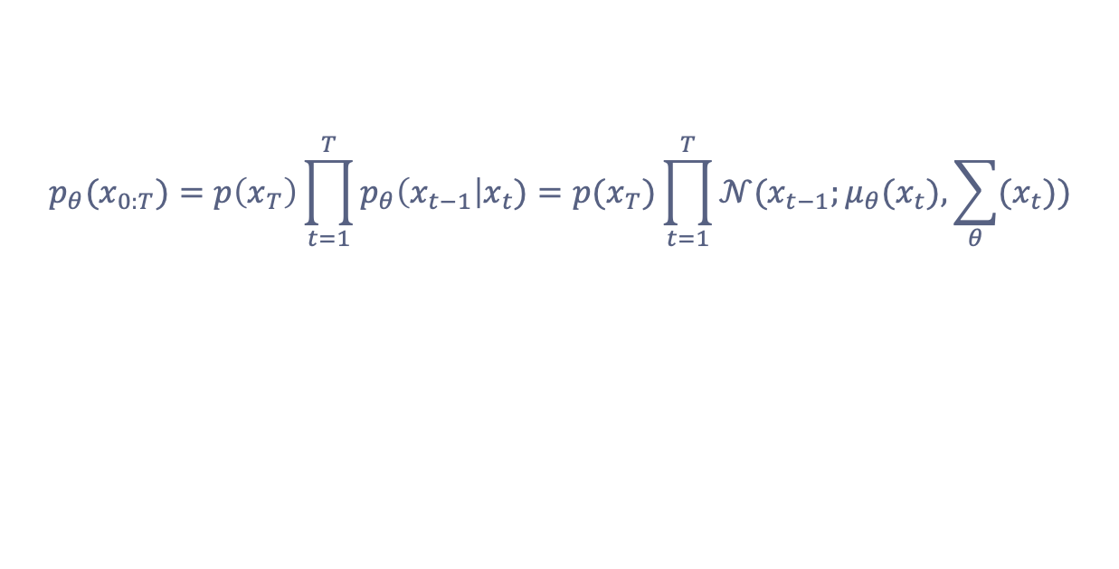
Reverse Process Equation
$$p_{θ}(x_{0:T})=p\left(x_{T}\right)\prod_{t=1}^{T}{p_{θ}\left(x_{t−1}\right|x_{t})=p(x_{T})\prod_{t=1}^{T}{𝒩(x_{t−1};μ_{θ}(x_{t}),\sum_{θ}{(x_{t}}))}}$$
October 2025 |

Slide 14

Diffusion model process (image generation)
October 2025 |

Slide 15
Diffusion Models (image generation) – Inputs
The diffusion model takes three inputs, each serving a crucial role:
Latent Vector - This represents your input image after being processed by the VAE (Variational Autoencoder) encoder. In simpler terms, it’s a compressed representation of your image data.
Context - This is the text prompt embedding obtained from the CLIP encoder. It links the text description to the image, guiding the diffusion process toward generating coherent outputs.
Timestep - A scalar value embedded as a vector, representing the current step in the denoising process. It helps the model understand when it is in the sequence of removing noise.
October 2025 |

Slide 16

UNET
UNet was originally introduced as an architecture for biomedical image segmentation, designed to handle the challenge of locating fine details in medical images.
UNET is able to perform really well using few annotated samples by leveraging its built in data augmentation, and is relatively fast compared to other methods.
October 2025 |

Slide 17
Classifier-free Guidance
Classifier-free guidance offers an elegant solution. Instead of using separate models for conditioned and unconditioned data, we use a single model and occasionally drop the prompt signal.
At each timestep, the model receives either the noisy image, the timestep, and the prompt to predict the noise to remove (conditioned case), or the noisy image and timestep without the prompt (unconditioned case). This way, the model learns both to generate images aligned with the prompt and without it.
October 2025 |

Slide 18
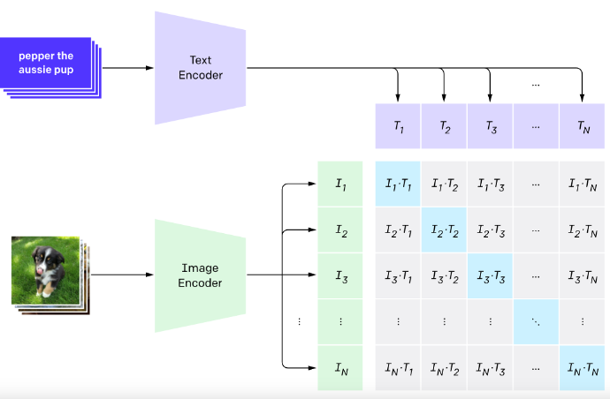
CLIP
October 2025 |

Slide 19
VEO 3 Architecture
October 2025 |

Slide 20
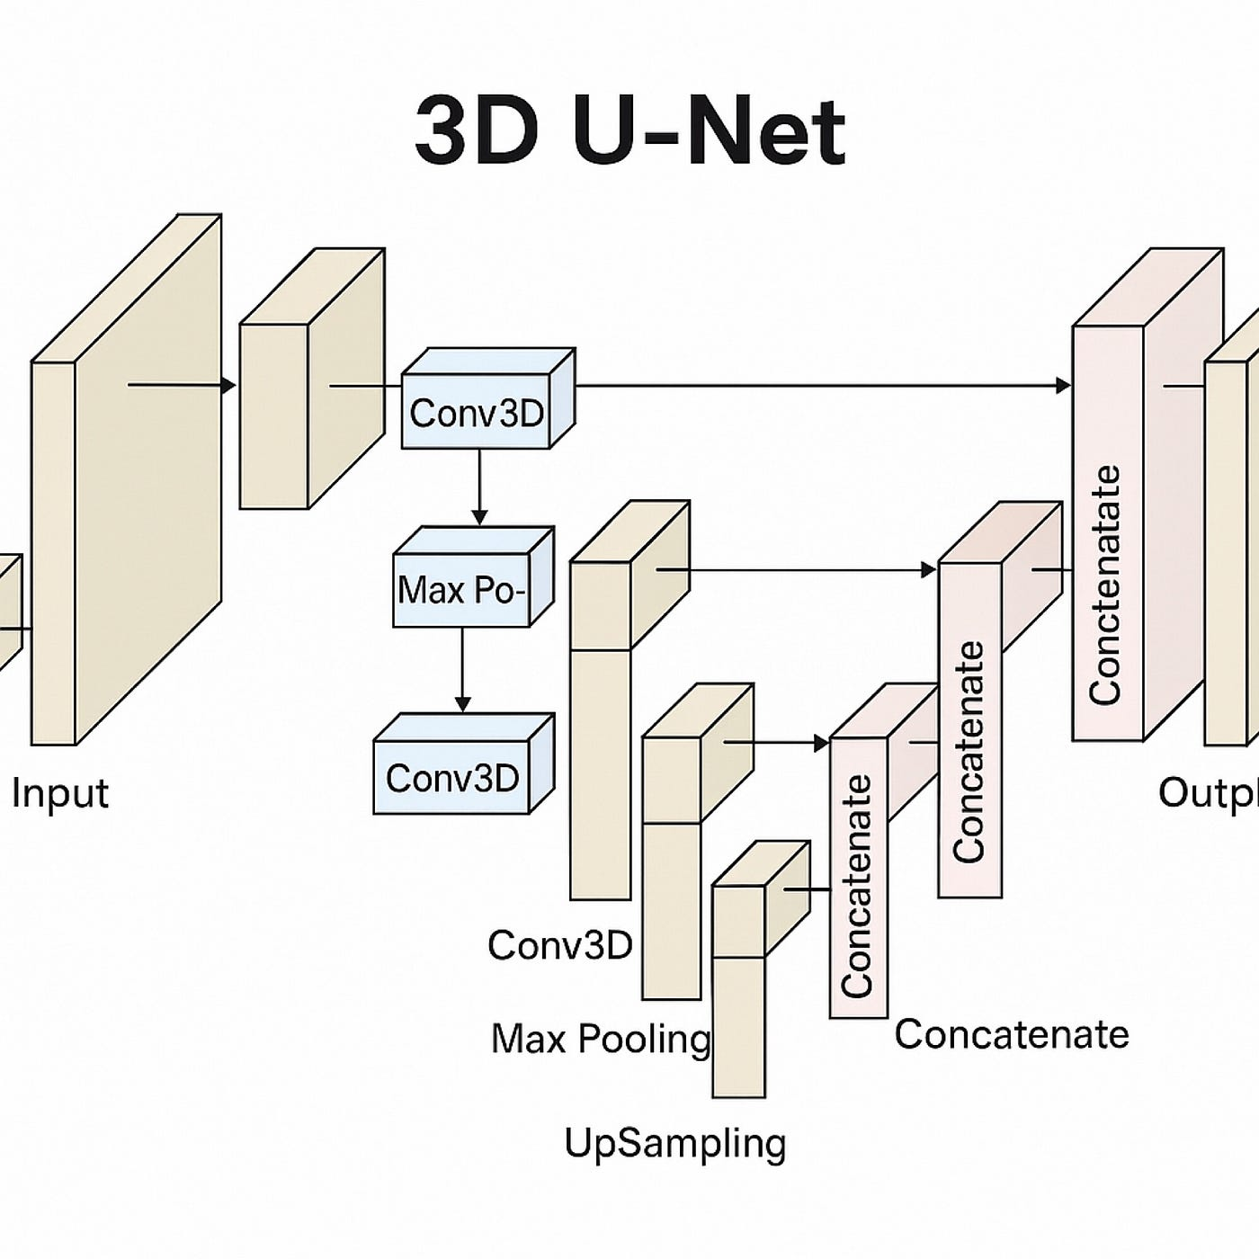
3D UNET
October 2025 |

Slide 21
Bottleneck of these Methods
Outputs one token at a time
Performance is amazing but they make mistakes (Factual errors, logical errors, inconsistency, limited reasoning)
Current models have no knowledge of the underlying reality. They have no common sense.
October 2025 |

Slide 22
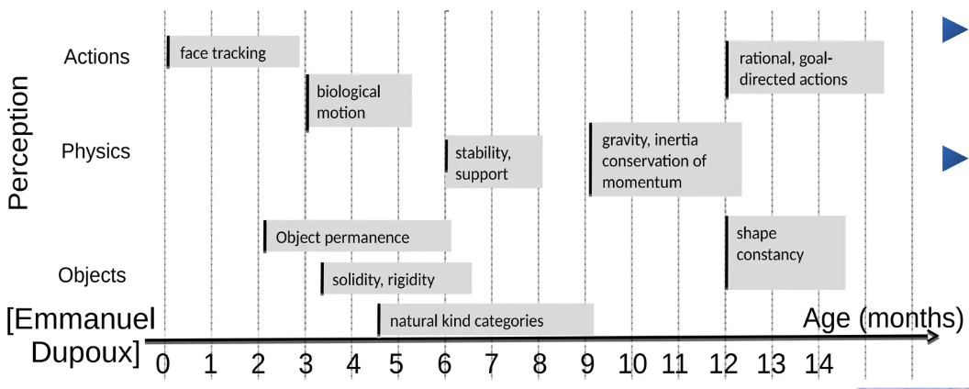
How could Machines Learn Like Animals & Humans
How can babies learn how the world works?
How can teenagers learn to drive with 20h of practice?
October 2025 |

Slide 23
3 Challenges for Machine Learning
Learning representations and predictive models of the world.
Learning to reason (Making reasoning compatible with learning)
Learning to plan complex action sequences.
October 2025 |

Slide 24
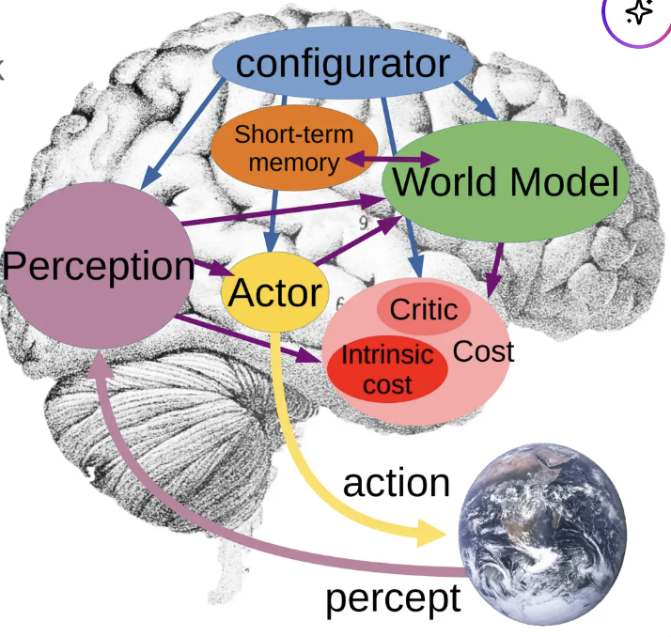
Modular Architecture for Autonomous AI
Configurator – configures other modules for task
Perception – estimates state of the world
World model – predicts future world states
Cost – Compute “discomfort”
Actor – Find optimal action sequences
Short-Term memory – Stores state-cost episodes
Source: A Path Towards Autonomous Machine Intelligence Version 0.9.2, 2022-06-27
October 2025 |

Slide 25
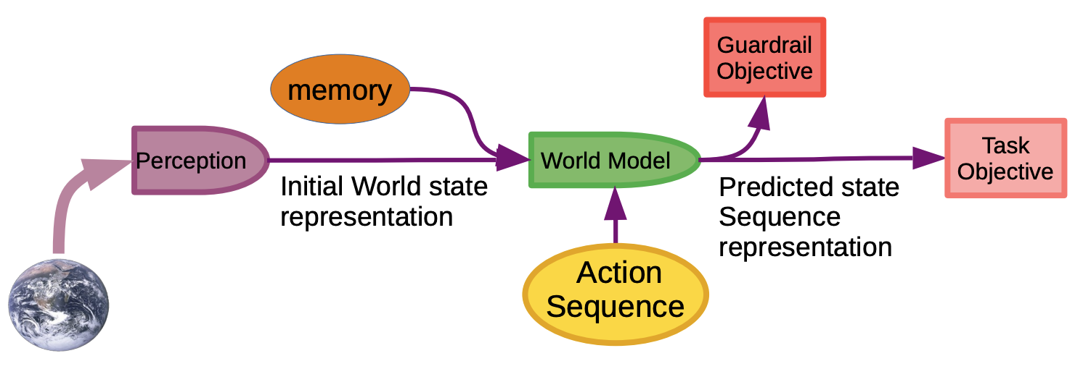
Objective Driven AI
The components of this architecture can be put together to build an intelligent system that follows human defined objectives.
October 2025 |

Slide 26
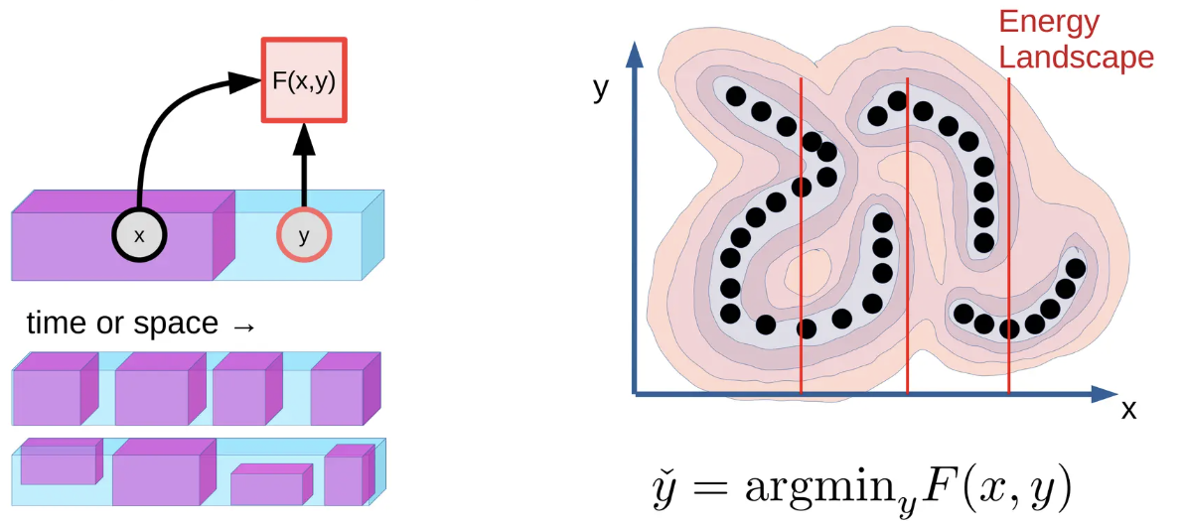
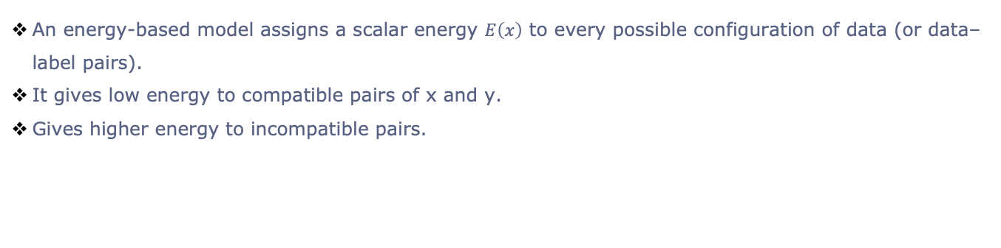
Energy-Based Models
An energy-based model assigns a scalar energy $E\left(x\right)$ to every possible configuration of data (or data–label pairs).
It gives low energy to compatible pairs of x and y.
Gives higher energy to incompatible pairs.
October 2025 |

Slide 27
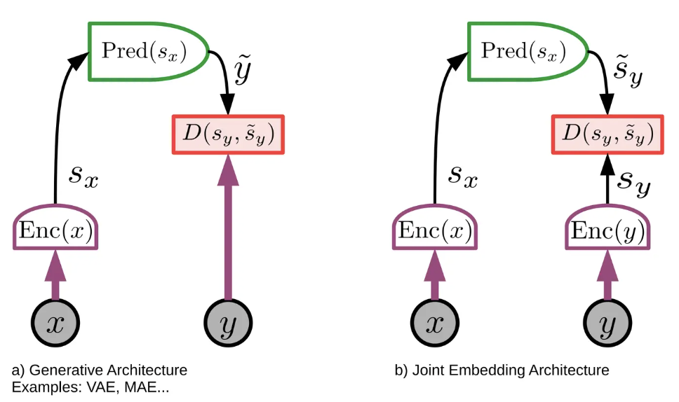
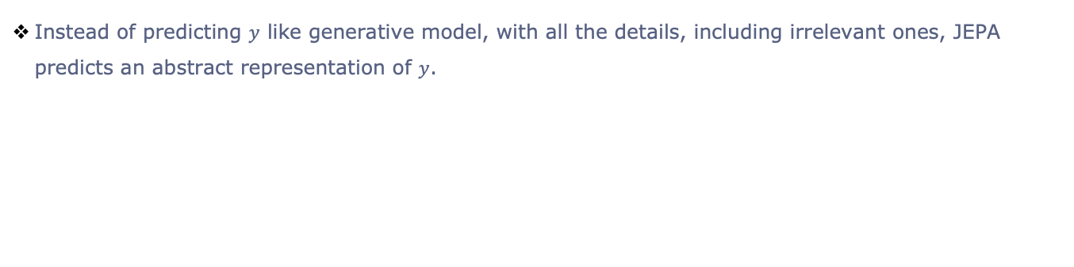
Joint-Embedding Predictive Architecture (JEPA)
Instead of predicting $y$ like generative model, with all the details, including irrelevant ones, JEPA predicts an abstract representation of $y$.
October 2025 |

Slide 28
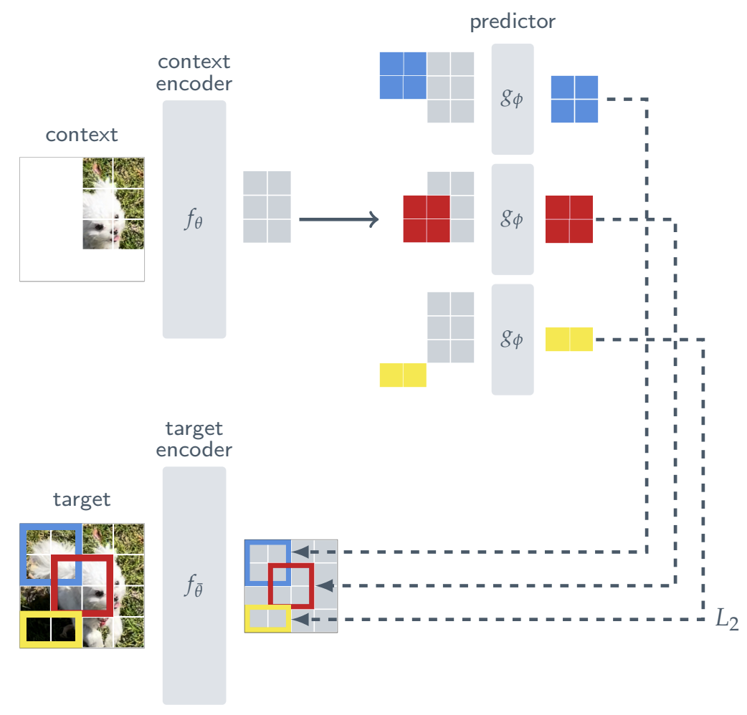
Joint-Embedding Predictive Architecture (JEPA)
October 2025 |

Slide 29
What Data is Needed?
In building a world model, we have to consider the fundamental differences in the type of data that humans and AI models process. Yann lists 5 modes of information gathering that an agent can use to learn its world model.
Passive observation: sensor stream without control
Action foveation: The agent can direct attention within the data stream
Passive agency: Observing another agent’s actions and causal effects
Active Egomotion: The sensors can be configured, for example moving a camera
Active Agency: Sensory streams that are influenced by the agent’s actions
October 2025 |

Slide 30
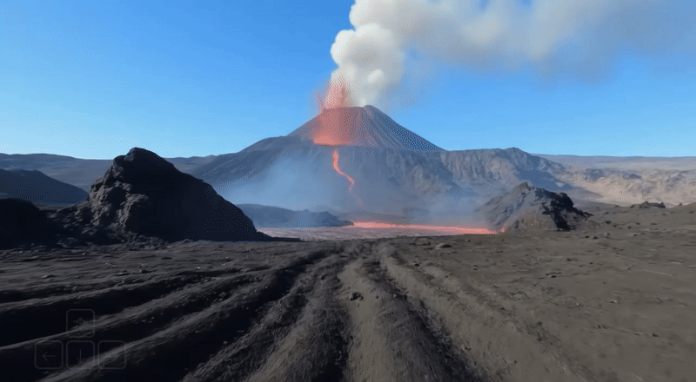
World Models
Prompt: The video shows a first person perspective of someone navigating difficult terrain in the middle of a volcanic area.
October 2025 |

Slide 31
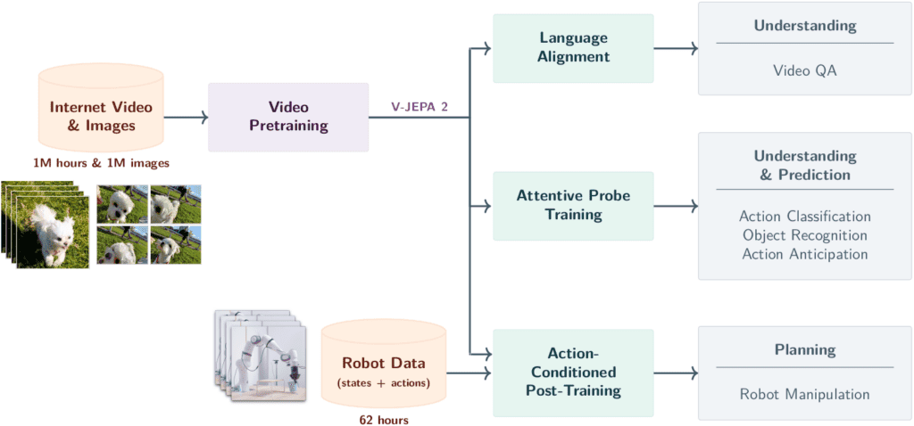
V-JEPA 1/2
October 2025 |

Slide 32
What do these models have in common?
October 2025 |

Slide 33
Multimodal Representation Learning
It aims to build unified models that understand, align, and integrate information across diverse modalities—such as text, images, audio, and video—through complementary strategies of representation, fusion, and generation. It can be split into 5 categories:
Representation & Alignment - Encode modalities into a shared or coordinated latent space
Fusion - Combine representations across modalities for joint reasoning
Cross-Modal Translation/Generation - Generate or translate one modality from another
Self-/Weakly- Supervised Learning - Learn from unlabeled or weakly paired web-scale data
Co-Learning / Cross-Modal Transfer - Use one modality to teach or distill another
October 2025 |

Slide 34
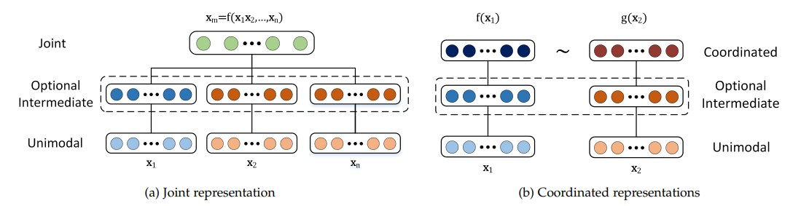
Multimodal Representation Learning
October 2025 |

Slide 35
Where these Models Still Break?
Temporal coherence - identity drift, lighting/props change across shots; long-horizon memory is weak
Physics & causality - brittle contact, hands, fluids; motion looks plausible but not causal
Text/symbols - on-object text, charts, UIs, music notation are unreliable (esp. across frames)
Long form & Multi-shot - quality decays with duration; seams between shots are visible
Evaluation & Data - no universal “coherence” metric; high-quality licensed video remains scarce; synthetic-on-synthetic drift
October 2025 |

Slide 36
Risks & biases (safety + creativity)
Misinformation & deepfakes - political deception, impersonation, harassment
Copyright, consent, privacy - training on unlicensed media; likeness/style appropriation
Bias & representation - skewed aesthetics; stereotyping and under-representation
Harmful content - non-consensual explicit media; minors; violent/abusive outputs
Environmental footprint - energy/water cost of training/inference
Opacity - closed data/weights; hard to audit or contest outputs
October 2025 |

